Slide 1


Adversary Emulation Framework
Mentors: Dr. Alcides Alvear Suarez & Robel Campbell
Integrants: Kiara Rivera Domenech, Genesis Resto, Carlos Roque
Date: September 19th, 2023

Slide 2
Table of Contents
Command and Control Framework (C2) and Structure Diagram context
Project Improvements: Implant, Server and Interface
Diagrams: Implant and Listeners tab
References
Q&A
G. Resto, K. Domenech, C. Roque Adversary Emulation Framework
2

Slide 3

Project Context
G. Resto, K. Domenech, C. Roque Adversary Emulation Framework
3

Slide 4

Command and Control Framework
Dynamic Evasion – Variable Syscalls, ETW/AMSI Patching
In-memory Execution – Download Cradles, Microcontroller
Encrypted Payloads – AES-256, XOR
G. Resto, K. Domenech, C. Roque Adversary Emulation Framework
4

Slide 5
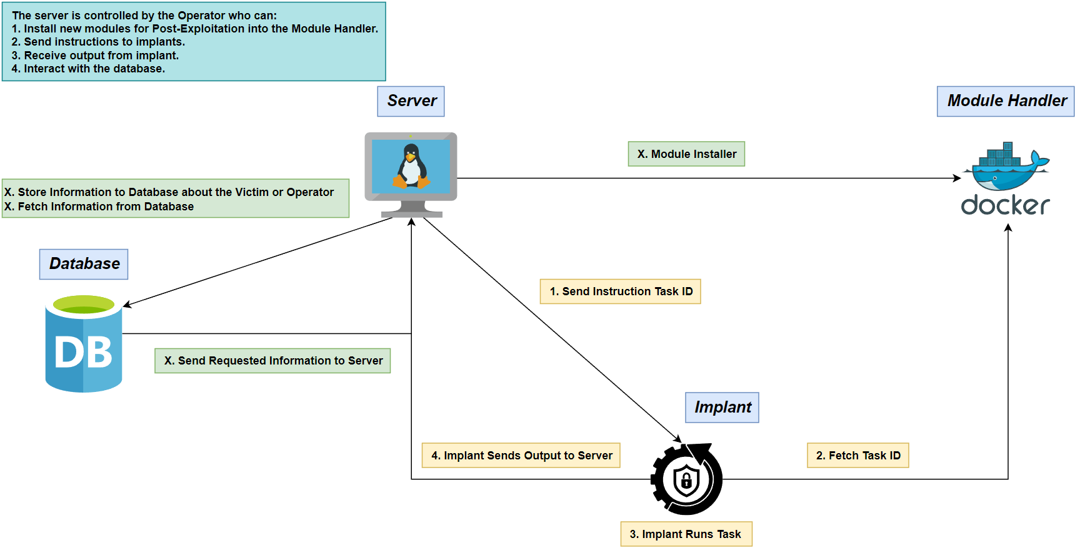
Structure Diagram
G. Resto, K. Domenech, C. Roque Adversary Emulation Framework

Slide 6
Initial Backlog Methodology: Scrum
G. Resto, K. Domenech, C. Roque Adversary Emulation Framework

Slide 7
Implant
Basic Post-Exploitation:
System Enumeration
Evasion Techniques:
Module Stomping
Heap Encryption
Thread Call Stack Spoofing
Persistence
Data Exfiltration
Anti-Debugging/Virtual Machine
Encryption
G. Resto, K. Domenech, C. Roque Adversary Emulation Framework

Slide 8

Server
Multiple Listener Creation
Authorization
GeoIP-Based Identification
Scriptable Modules
G. Resto, K. Domenech, C. Roque Adversary Emulation Framework

Slide 9

Interface
Real-time Monitoring for Implant
New tabs:
Listener Creation
G. Resto, K. Domenech, C. Roque Adversary Emulation Framework
9

Slide 10
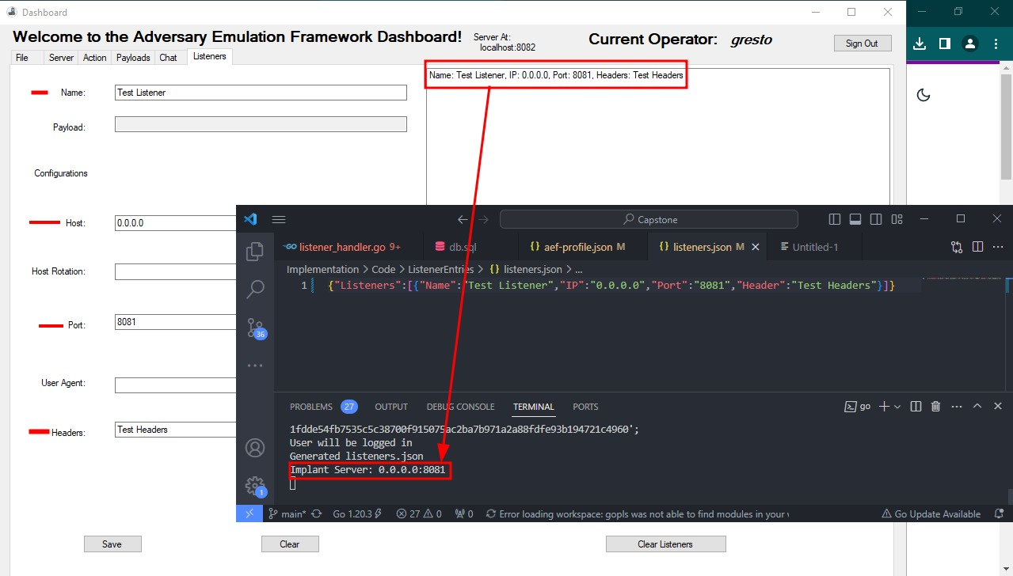

Slide 11

Module Handler
Upload sharp collection
Python script for downloading modules
Custom DLL code
G. Resto, K. Domenech, C. Roque Adversary Emulation Framework

Slide 12
Diagrams

Slide 13
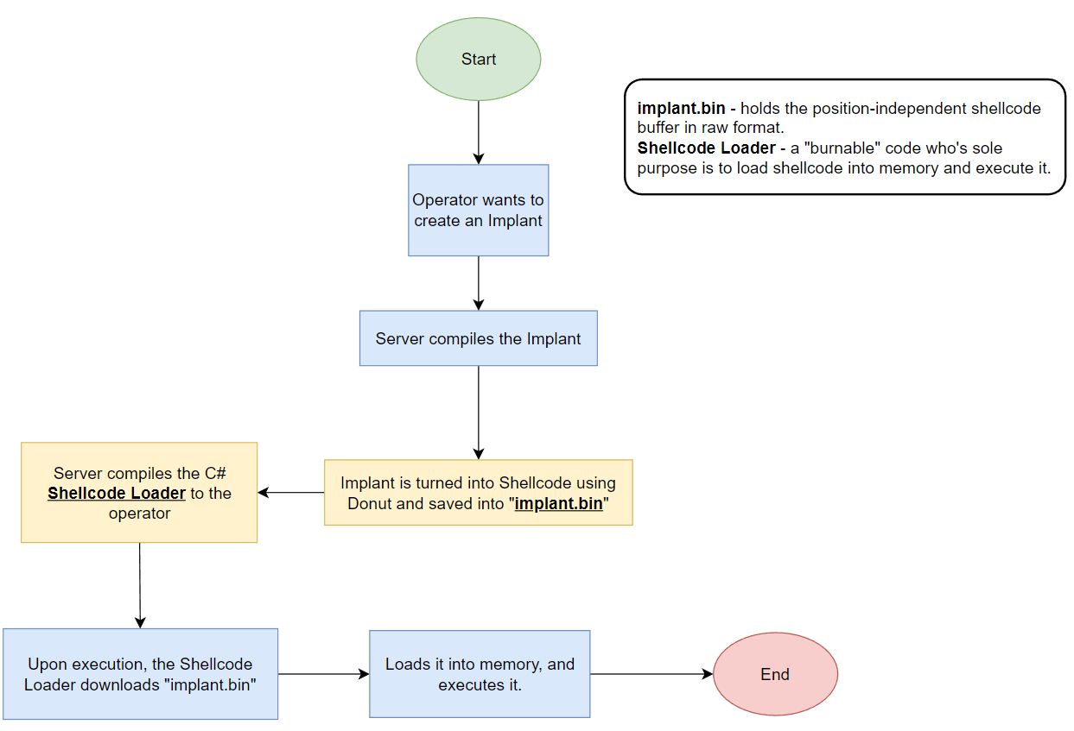
Implant Loading
G. Resto, K. Domenech, C. Roque Adversary Emulation Framework

Slide 14
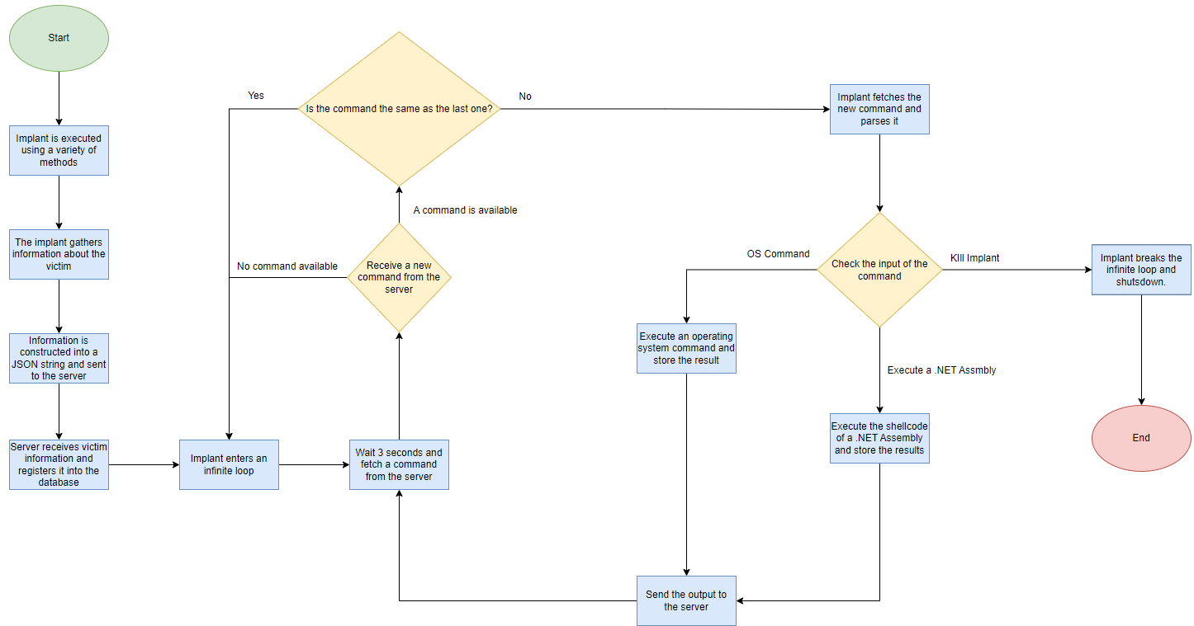
Implant Execution
G. Resto, K. Domenech, C. Roque Adversary Emulation Framework

Slide 15
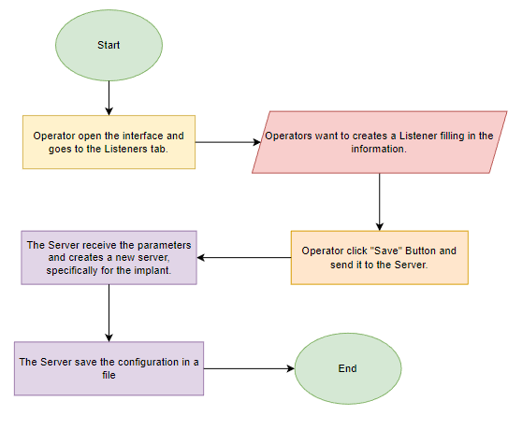
Listeners Creation

Slide 16
References
Microsoft (2023, February). Dynamic Language Runtime Overview - .NET Framework. Microsoft Learn. https://learn.microsoft.com/en-us/dotnet/framework/reflection-and-codedom/dynamic-language-runtime-overview
Ali Awan, A. (2022, July). A Comprehensive Introduction to Graph Neural Networks (GNNs). https://www.datacamp.com/tutorial/comprehensive-introduction-graph-neural-networks-gnns-tutorial
G. Resto, K. Domenech, C. Roque Adversary Emulation Framework
16

Slide 17

Thank you

